Slide 1
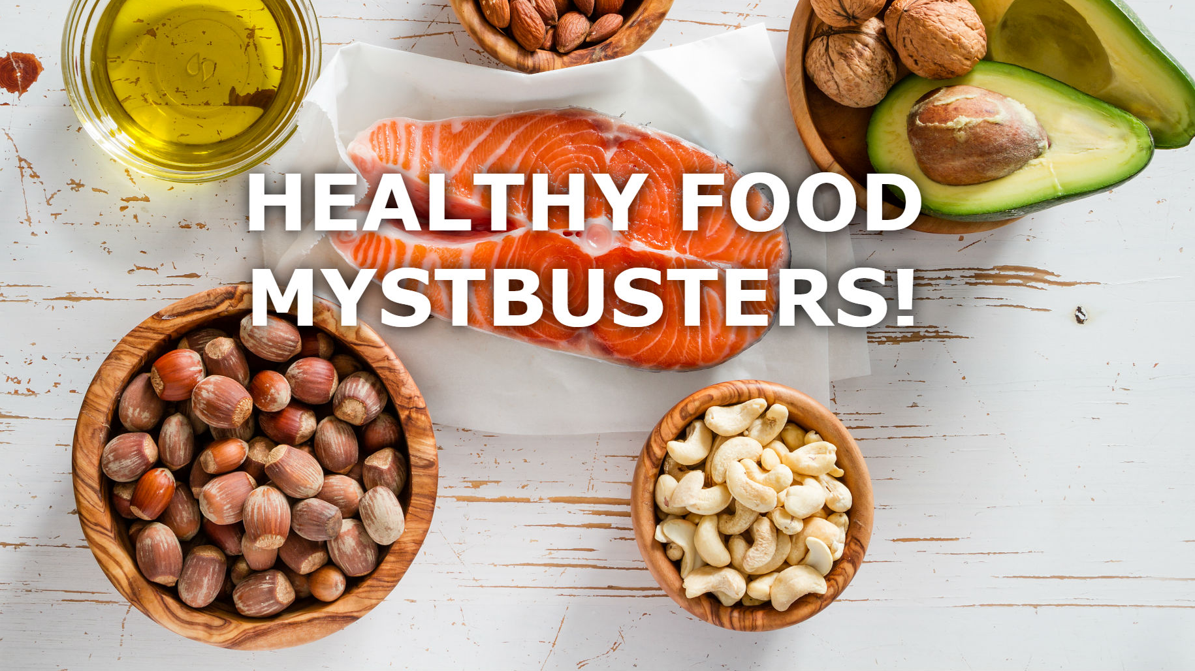
Too much of a good thing: avocado?
Qing (Ray) Chang

Slide 2
Business Problem
Data Preparation
Model Development
Model Evaluation
Solution Deployment
Brief description of business problem, success criteria, and analytical objectives/approach:
- Business Problem: If Avocado has most of the nutrition that body needs, does it really help people getting healthier as they consume it more?
Objectives: As a Non-profit organization (Mythbusters), our goal is to find if there’s an relationship between Avocado’s sale volume and people’s health KPI(Stroke, Cardiovascular(CVS), Diabetes) from 2015 -2017
Success Criteria: Find the correlation between Avocados sales(from2015-2017) and the 3 types of diseases

Slide 3
Business Problem
Data Preparation
Model Development
Model Evaluation
Solution Deployment
- Resources: (Data from HASS Avocado Board/Data from Community Health Status Indicators (CHSI))
- Constraints: The datasets for the research were based on samples from each region in US. Not the entire US population.
- Risks: This research is not a health claim, it is a representation that states a relation exists between a food or component of that food and health. It is for reference only.
- Costs & Benefits
Both documents are provided by Government Site and NFP organization with no charge.
Purpose of this research is to provide a better understanding of the relation between avocado sales and diseases in US.

Slide 4
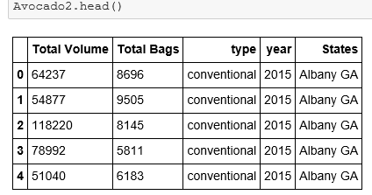
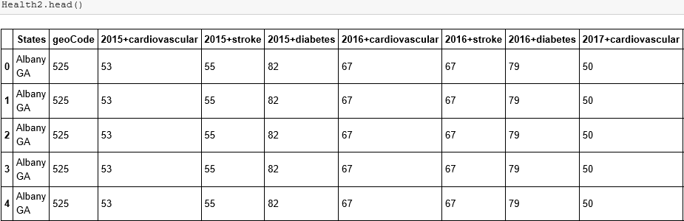
Business Problem
Data Preparation
Model Development
Model Evaluation
Solution Deployment
Acquire
Assess
Discover
Augment
Collect Initial Data: Initial Data Collection Report
Avocado data report from 2015 -2018 (partial)
CHSI from 2015-2017 for US
- Clean Data: Drop off all the columns that do not need.
Avocado: Health KPI:
(see Notebook for detail)

Slide 5
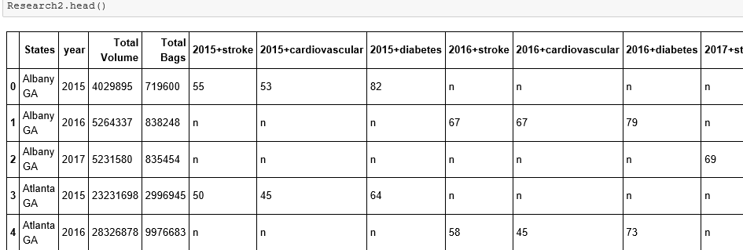
Business Problem
Data Preparation
Model Development
Model Evaluation
Solution Deployment
Acquire
Assess
Discover
Augment
- Construct, Integrate, Merged Data
(see Notebook for detail)

Slide 6
Business Problem
Data Preparation
Model Development
Model Evaluation
Solution Deployment
Loading Data into Models:
- Simple Linear Regression (model coefficient: intercept and slope)
Stroke KPI (x) vs. Total Volume (y)
y=11426390+241678.7x
Cardiovascular KPI vs. Total Volume
y=31288390+(-141402)x
Diabetes KPI vs. Total Volume
y=(-82892)+349680x
Using the Model for Prediction
If we would like to get our HealthKPI to 80, how many Avocado need to be sold each year?
StrokeKPI: need to sale *30M (vs. 2017- 26M)
CVS KPI: need to sale19M (vs. 2017- 26M)
Diabetes KPI: need to sale 27M(vs. 2017- 26M)
*30M = 30,000,000 (Sales of Avocado)
Based on the Linear Regression, there might be a positive correlation between the Stroke KPI & Diabetes KPI and Total Sale Volume
A negative correlation between Cardiovascular KPI and Total Sale Volume
***need to be tested again in other models

Slide 7
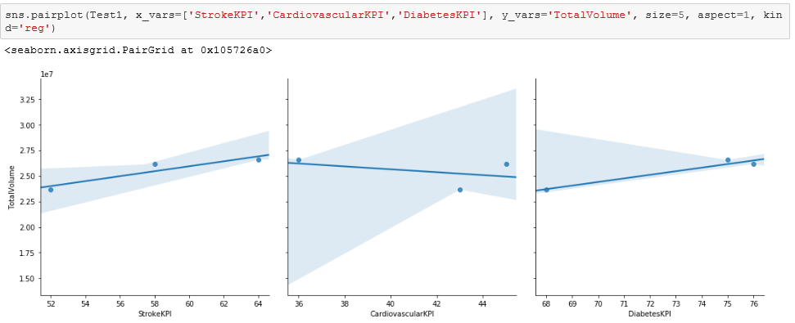
Business Problem
Data Preparation
Model Development
Model Evaluation
Solution Deployment
Loading Data into Models: Least Squares Line (still showing a positive correlation between Stroke & Diabetes KPI and Total Sale Volume)

Slide 8
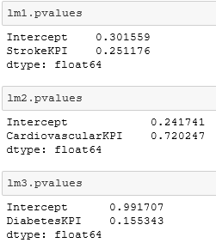
Business Problem
Data Preparation
Model Development
Model Evaluation
Solution Deployment
Loading Data into Models: P-Value and Hypothesis:
Null hypothesis: There is no positive correlation between Diseases and Avocado Sales (and thus β1 equals zero)
Alternative hypothesis: There is a positive correlation between Diseases and Avocado Sales (and thus β1 is not equal to zero)
Not enough evidence to reject the null hypothesis and accept the claim, Because P-Value is not between 0.003 ~0.05
So… no correlation at all ?
Let try other models to find out…

Slide 9

Business Problem
Data Preparation
Model Development
Model Evaluation
Solution Deployment
Loading Data into Models: Multiple Linear Regression
y=β0+β1×StrokeKPI+β2×CVSKPI+β3×DiabetesKPI
It indicates that,
an increase of 1 in StrokeKPI is associated with an increase in Avocado Sales of 151,604 in US
An increase of 1 in CVSKPI is associated with an increase in Avocado Sales of 35,092 in US
An increase of 1 in DiabetesKPI is associated with an increase in Avocado Sales of 189,504 in US

Slide 10
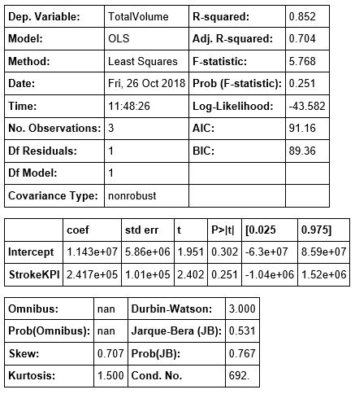
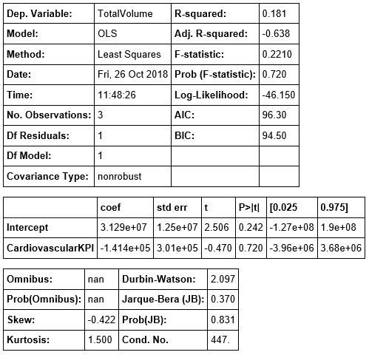
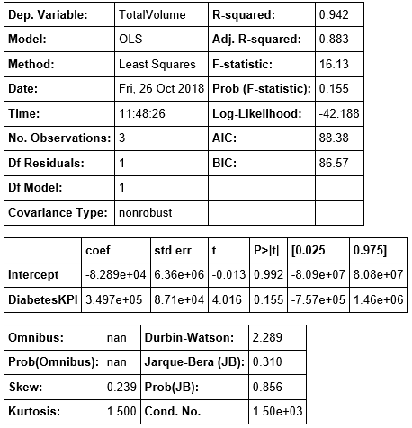
Business Problem
Data Preparation
Model Development
Model Evaluation
Solution Deployment
Loading Data into Models: R-square (shows more evidence there’s no correlations)
Stroke: CVS: Diabetes:

Slide 11
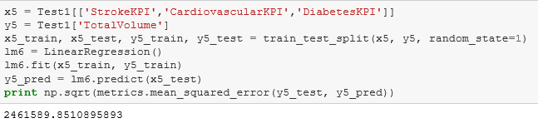
Business Problem
Data Preparation
Model Development
Model Evaluation
Solution Deployment
Brief description of the model evaluation stage, comparing your models among each other and deciding on winner.
- No Winners
- Model Evaluation Using Train/Test Split : MSE (mean squared error)
2,461,589 is the difference between the actual observations and the observation values predicted by the model

Slide 12
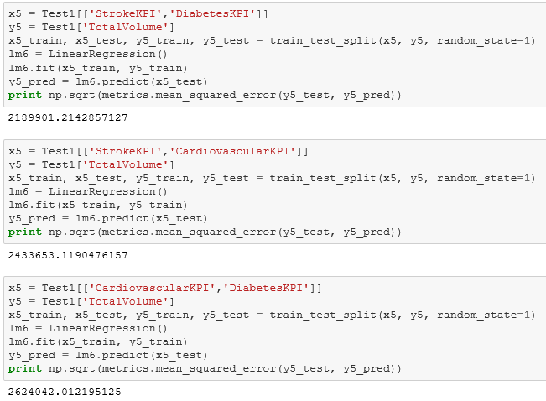
Business Problem
Data Preparation
Model Development
Model Evaluation
Solution Deployment
Continue on Train/Test Split : MSE (mean squared error)
Let's remove some of the variables, see if it will change the model's predictive ability
The difference between the actual observations and the observation values predicted by the model is still huge, regardless which variables removed
So we can safely say that there's no strong correlation between Avocado Sales and Health KPIs
However, with more data come in the future, it might start showing a positive correlation

Slide 13
Business Problem
Data Preparation
Model Development
Model Evaluation
Solution Deployment
Based on the analysis, there is no association between CVSKPI and Sales.
However, Stroke and Diabetes KPIs are showing slightly positively associated with Avocado Sales. Since the both KPIs and Sales we selected are from 2015- 2017 (3 years), it can be concluded that Health KPI and sales do not have a strong positive correlation
But with more data to put in the future, the result might be vary.
Therefore, we don’t think that there is any strong connections between Stroke, Cardiovascular, Diabetes and how often you consume Avocado, as long as you have a balanced whole foods-based diet with lots of variety.

Slide 14

Thank you!

